Slide 1
Healthcare Data Analysis using SQL
By- Ankush
www.linkedin.com/in/ankushsinghpec/
www. github.com/Ankush-Singh-1/Healthcare-Data-Analysis-SQL

Slide 2
Business Case Scenario
A mid-sized, multi-branch medical center handles thousands of patient admissions yearly. With rising healthcare costs and increasing patient volume, hospital management seeks to leverage data-driven insights to optimize operations, reduce expenses, and improve patient care outcomes. Currently, the hospital lacks clear visibility into billing trends, treatment patterns, and resource utilization across departments.
As a data analyst, my role is to analyze hospital data to uncover patterns in billing, length of stay, medication usage, and insurance behavior. The insights generated will guide strategic decisions such as renegotiating insurance contracts, streamlining treatment protocols, and improving patient turnover times, ultimately enhancing operational efficiency and patient care quality.

Slide 3
Steps taken to solve
->Data Exploration – 1.check entire data
2. check unique category
3. Summary stats (Min,Max,Avg)
->Data cleaning – 1. check null and remove if there is a null value.
2. check for duplicates and remove them or update.
->Data analysis – solve business problems asked by hospital.

Slide 4
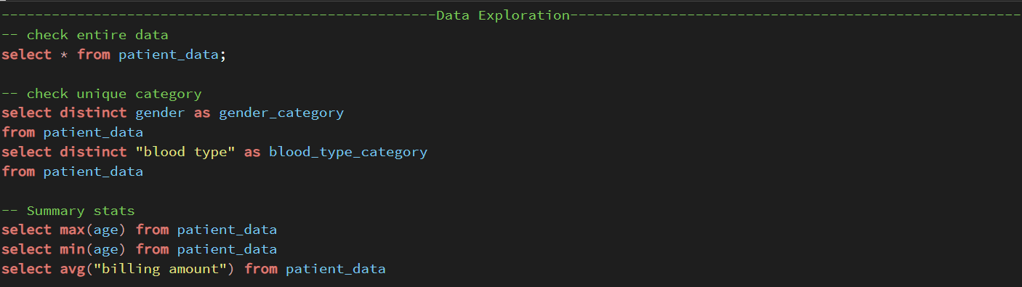
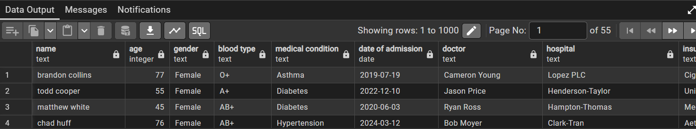
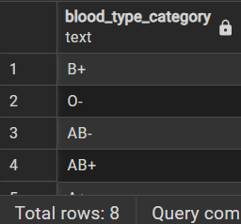
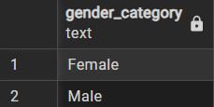




Slide 5
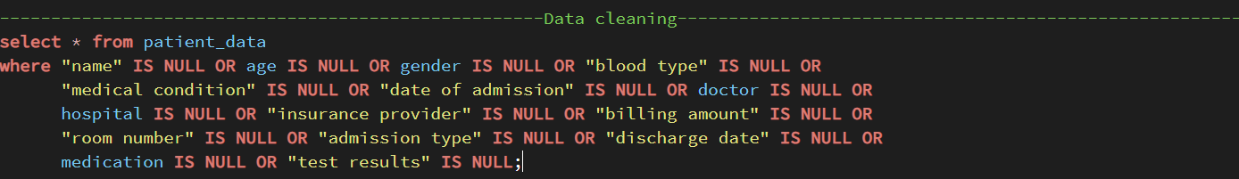
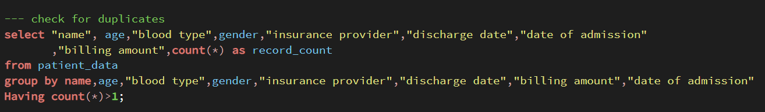
*No null value were present in data
*No ouput here has duplicates were removed when code was run for first time back then.

Slide 6
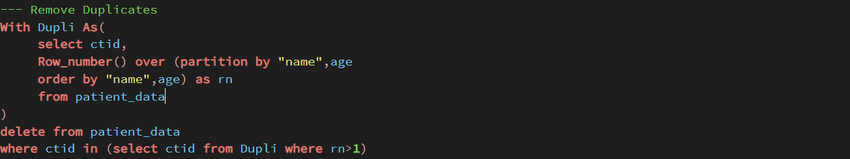
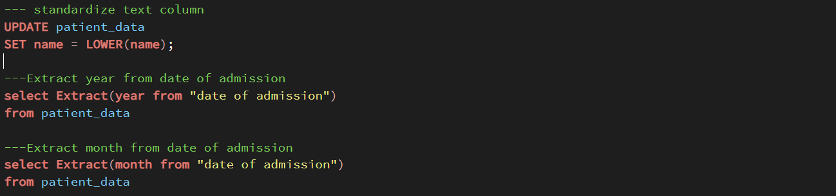
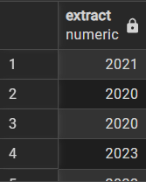
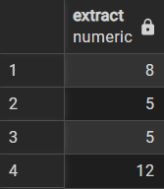

Slide 7
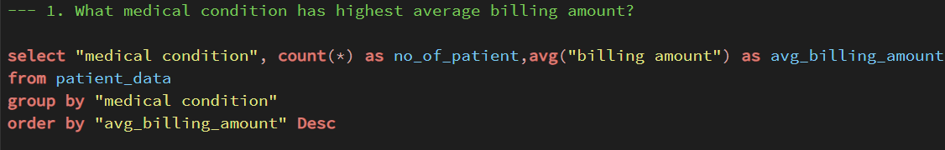
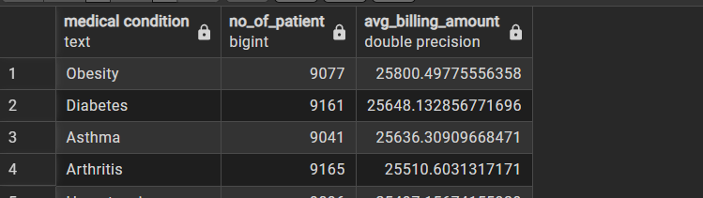
Business Questions

Slide 8
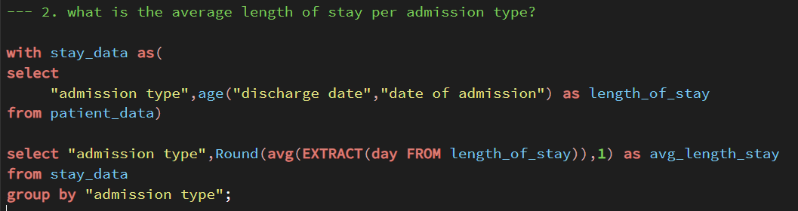
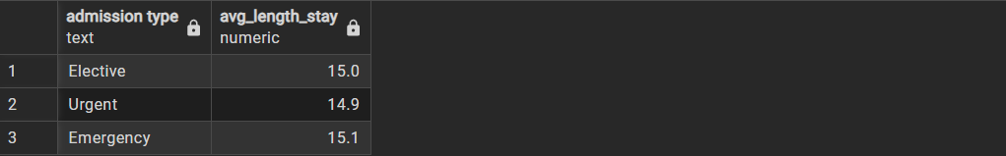

Slide 9
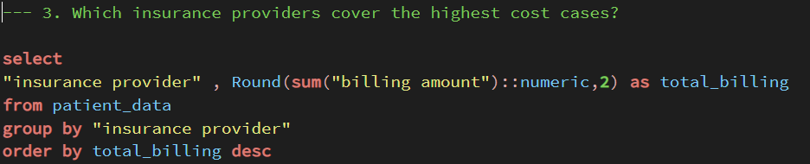
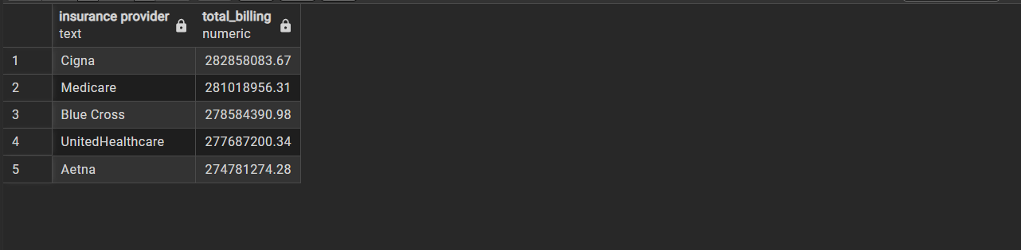

Slide 10
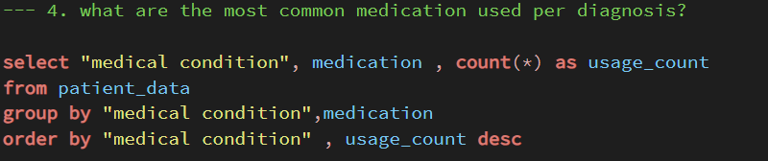
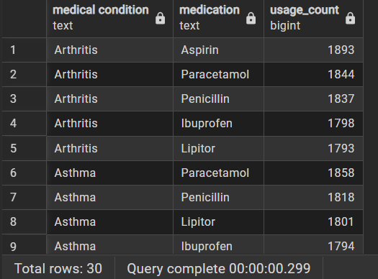

Slide 11
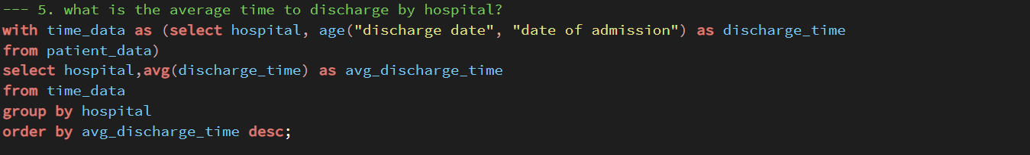
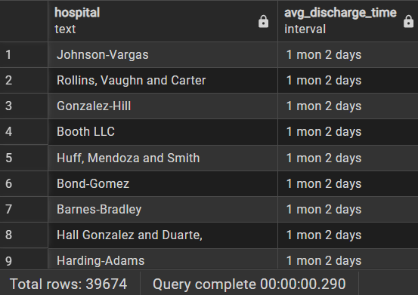

Slide 12
Conclusion
Through this analysis, we've uncovered valuable insights into hospital operations, highlighting opportunities to reduce costs, optimize care delivery, and enhance patient outcomes. By leveraging data on billing, treatment patterns, and insurance behavior, the hospital can make smarter, faster decisions—driving efficiency, improving care quality, and supporting long-term strategic goals.

Slide 13


